Slide 1
Mobile Cloud Supported Smart Light IoT System
Dr. Kewei Sha
Sai Lochan Reddy Reddipalli, Sasidhar Pasupuleti, Raghuram Kambhampati, Rohith Raj Reddy Alla Sai Poorna

Slide 2
Introduction

Slide 3
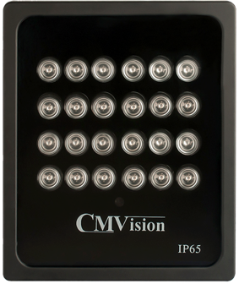
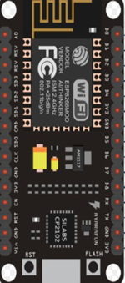
Abstract
Our Project develops a Mobile Application which enables cloud connection and control for a traditional Led Light.
With this app the users can remotely configure the light by changing the schedule of operations, RGB patterns and the intensity.
This is achieved through a user-friendly Mobile and Web Interface
This allows new user and device registration through a QR code for a secure connection.

Slide 4
Objectives
Develop a Mobile Application with a seamless User Interface on the iOS Platform.
Use Wi-Fi as the communication protocol between the devices.
Connect the Light with NodeMCU.
Provide a secure connection by registering users and adding devices through QR code.
Enable remote access for controlling the light through the internet.
Create a database to collect session data and enable cloud connection.
Read light status, change RGB pattern, change intensity and set schedule for the light through a mobile and web interface.

Slide 5

Motivation
“Executives rank the Internet of Things as their top technology priority, it’s becoming a competitive differentiator that will affect almost every industry.”
-Bruce Rogers, Chief Insights Officer at Forbes Media.
Market for Internet of things (IoT) is projected to hit $267 billion by 2020. Many traditional companies are trying to parlay IoT into connected services which can create tangible value and profit.

Slide 6
Methodology

Slide 7
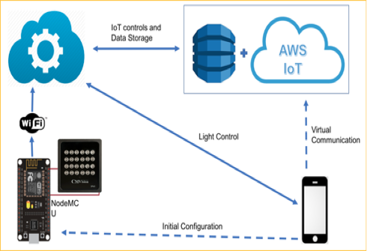
Architecture

Slide 8
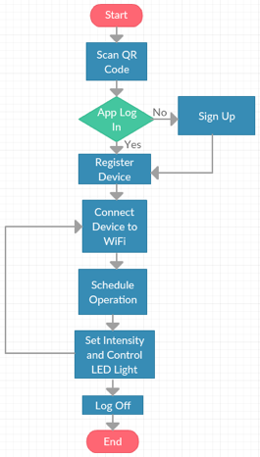
Proposed System
The system consists of CMVision Light, NodeMCU , AWS and Mobile application.
The light is connected to NodeMCU and controlled by it.
The mobile application will initially connect with NodeMCU configured as a hotspot.
The user configures NodeMCU to connect with home Wi-Fi using the mobile application.
The application holds a variety of options and settings to control the light. The user can select an option and can interact with the light through a mobile or web interface.
The commands from the mobile and web interfaces go through the AWS cloud database to reach the light.

Slide 9
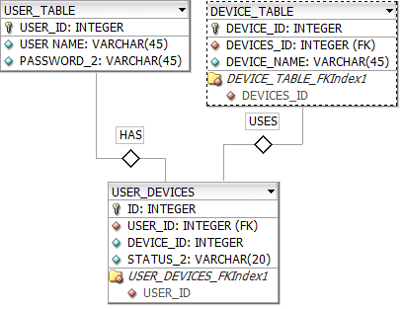
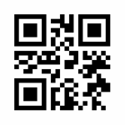
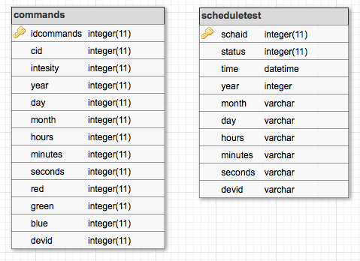
Database Schema on AWS
Device Registration
Device Registration
Device Registration

Slide 10
Implementation

Slide 11
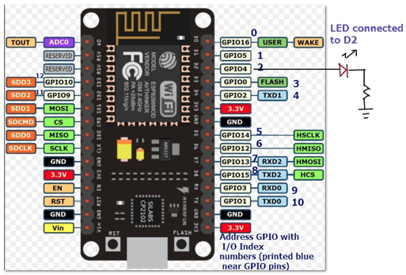
Hardware

Slide 12
NodeMCU
Used Arduino IDE as a code editor to program NodeMCU with C++ language
Wi-Fi based device with STA and AP mode
Predefined Libraries used
ESP8266WiFi.h
DNSServer.h
ESP8266WebServer.h
ESP8266HTTPClient.h
ArduinoJson.h
Libraries created
updateTime.h
requestCommand.h
scheduleCommand.h
getUserName.h
Setup( ) function configures the initial setup mode
Loop () function keeps requesting the commands from AWS

Slide 13
NodeMCU routine
Device switches on with SoftAP mode and keeps running a webserver
Connects to previously connected WiFi if available
Else waits to be connected to new Wi-Fi with help of Mobile app
Device needs to be registered to user with mobile
requestCommand( ) function keeps requesting for all the commands
scheduleCommand( ) function checks for any set timed command
updateTime( ) function updates and synchronizes the device time
AWS accepts the requests from the device and serves the command
Commands are processed in First in First out mode
Scheduling commands are expired once executed

Slide 14
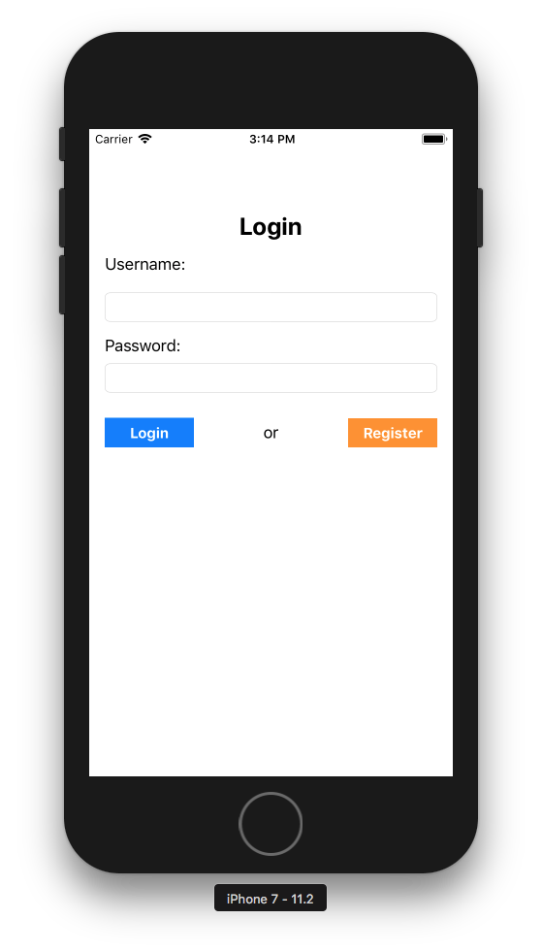
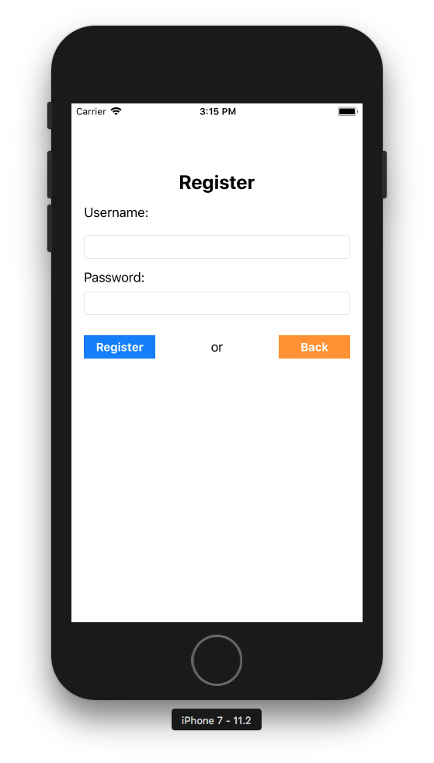
Mobile Application UI
Login View Controller Register View Controller

Slide 15
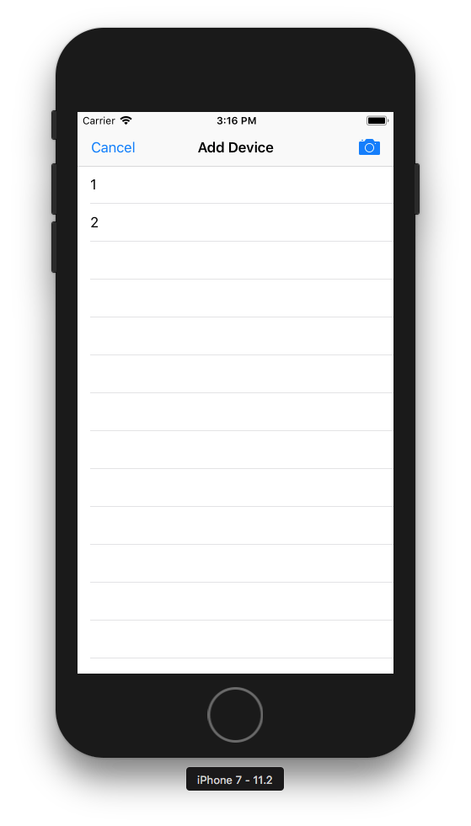
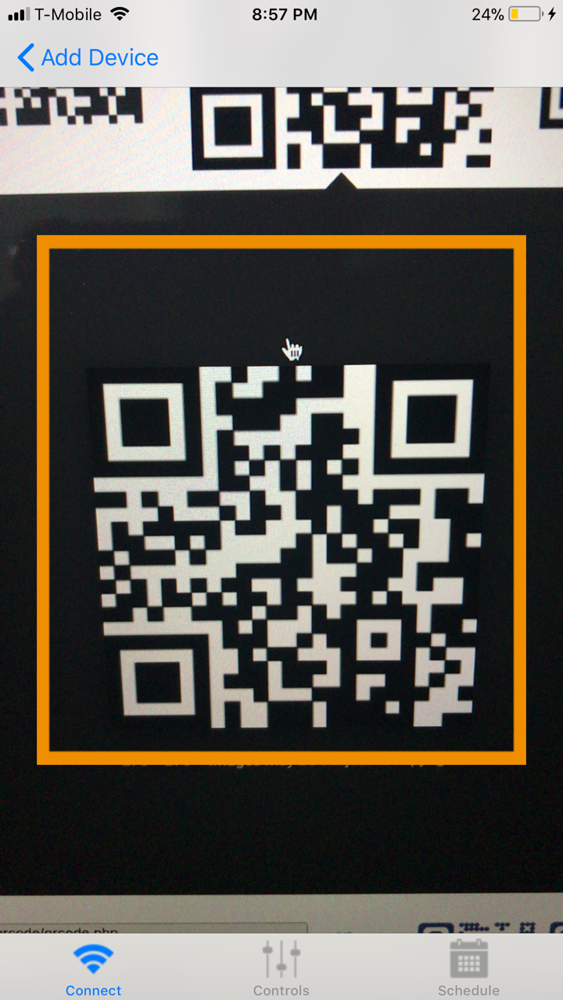
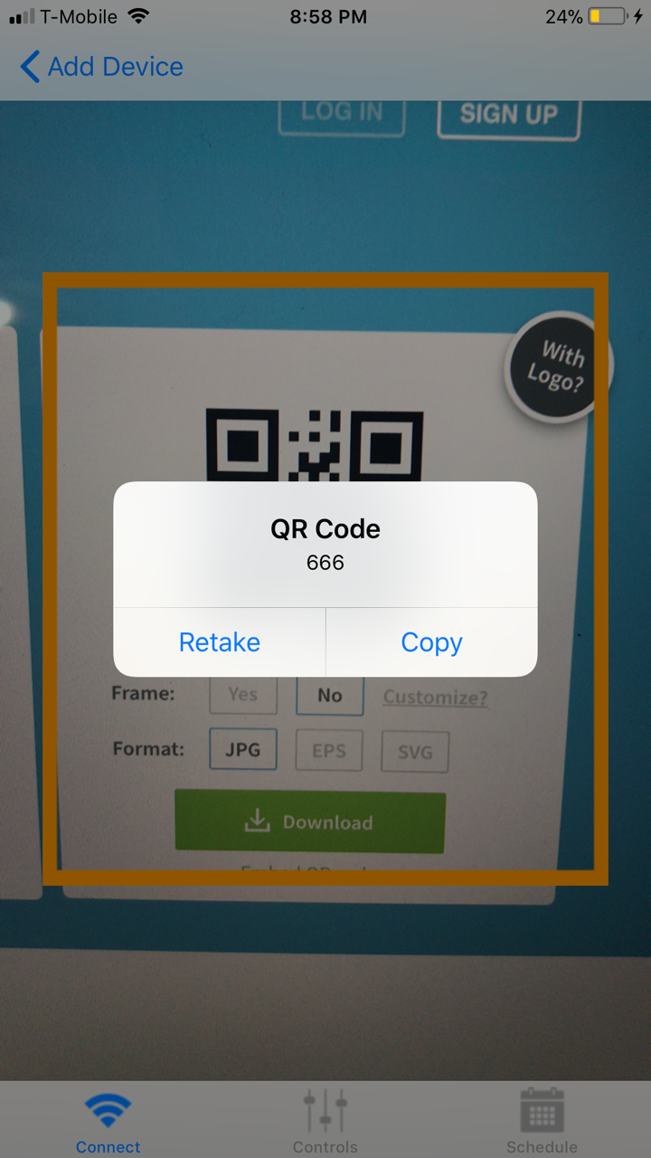
Mobile Application UI
Device View Controller Add Device View Controller

Slide 16
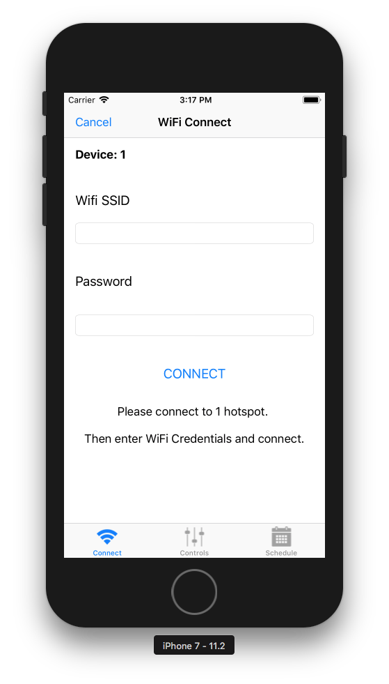
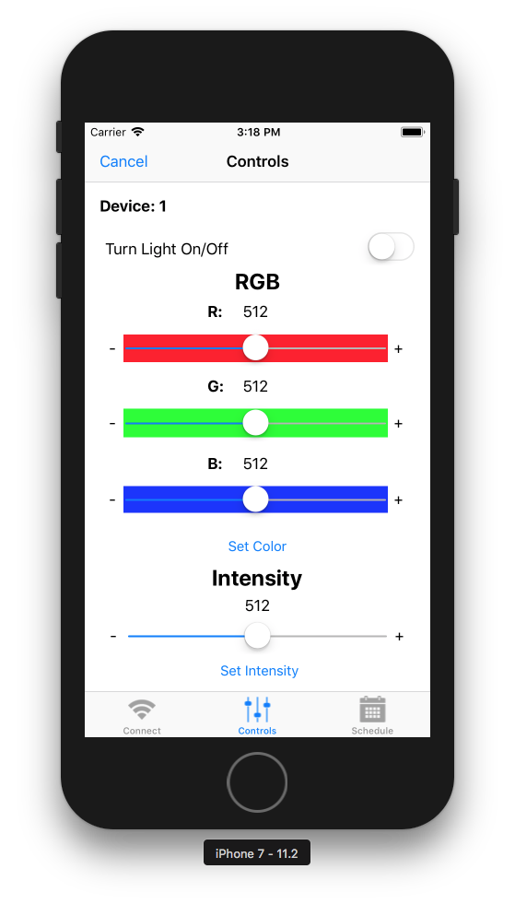
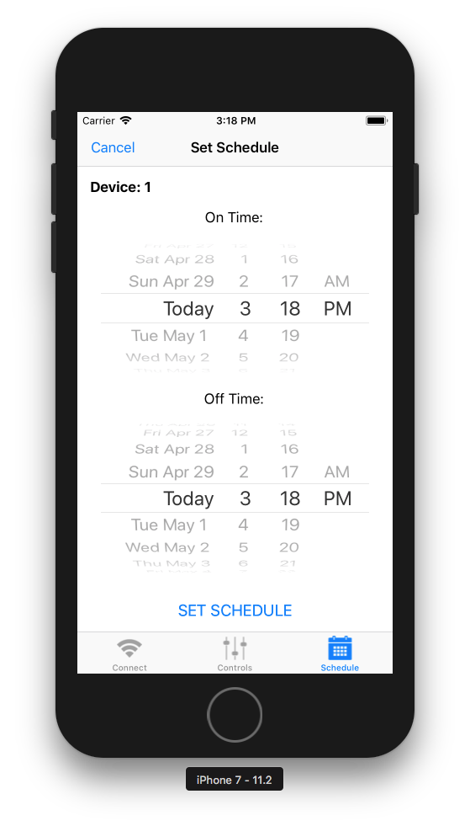
Mobile Application UI
Connect View Controller Control View Controller Schedule View Controller

Slide 17
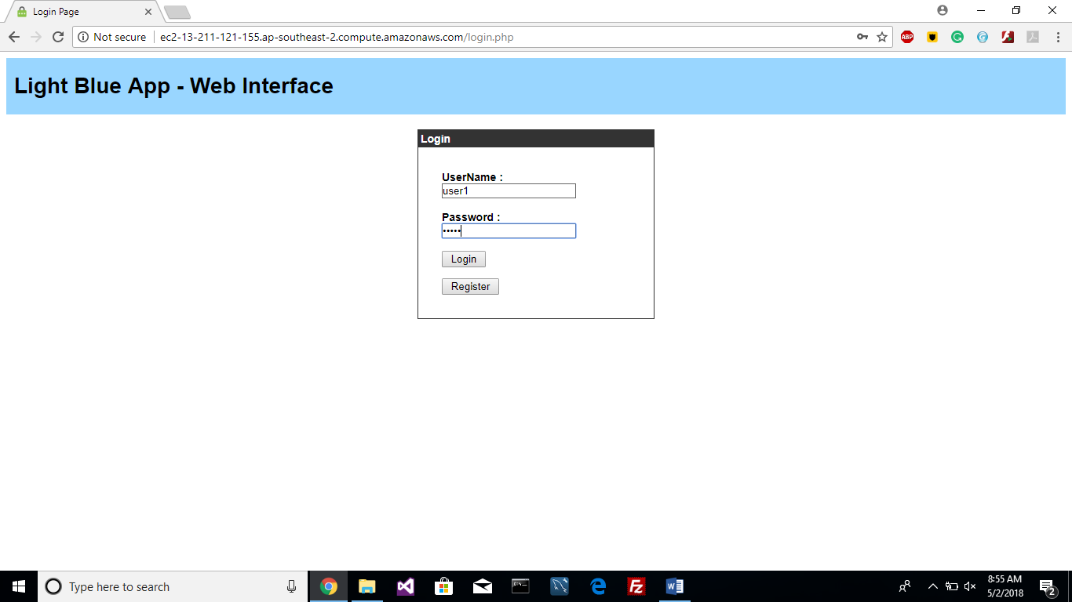
Web Interface
Login Page

Slide 18
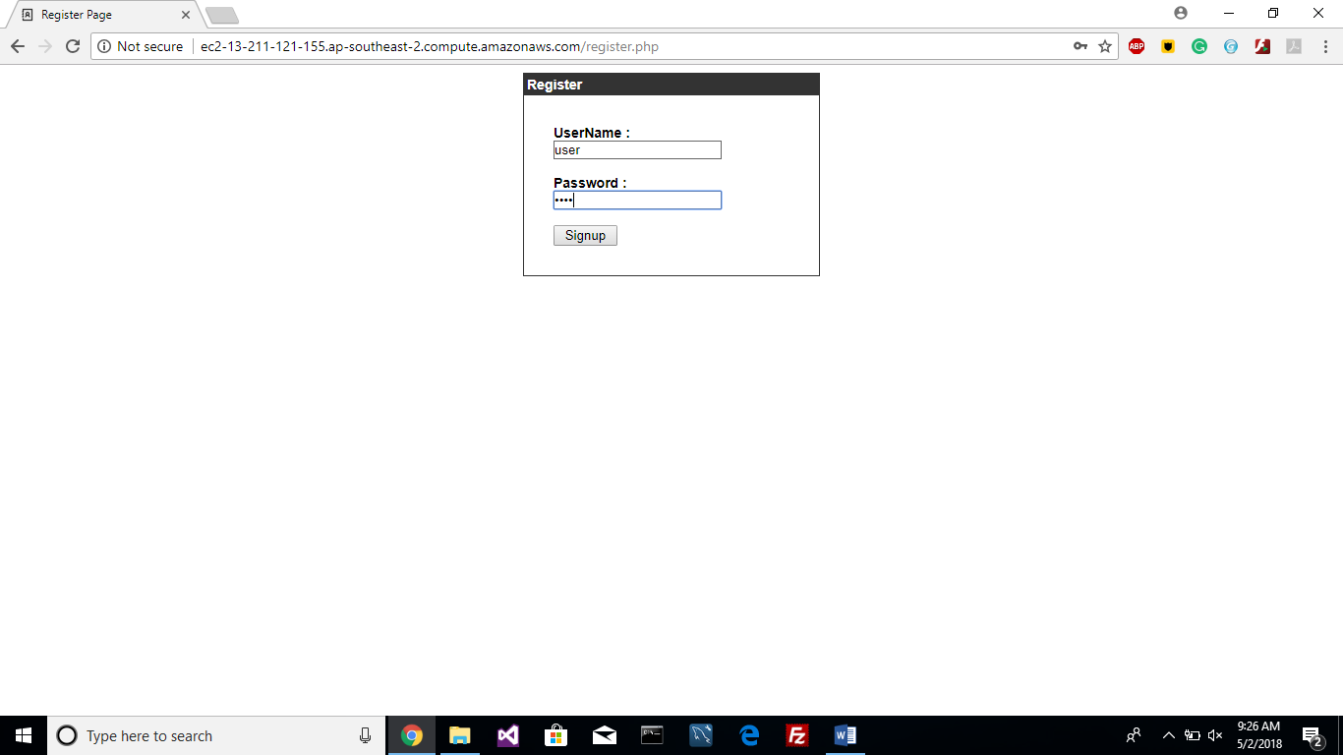
Web Interface
Register Page

Slide 19
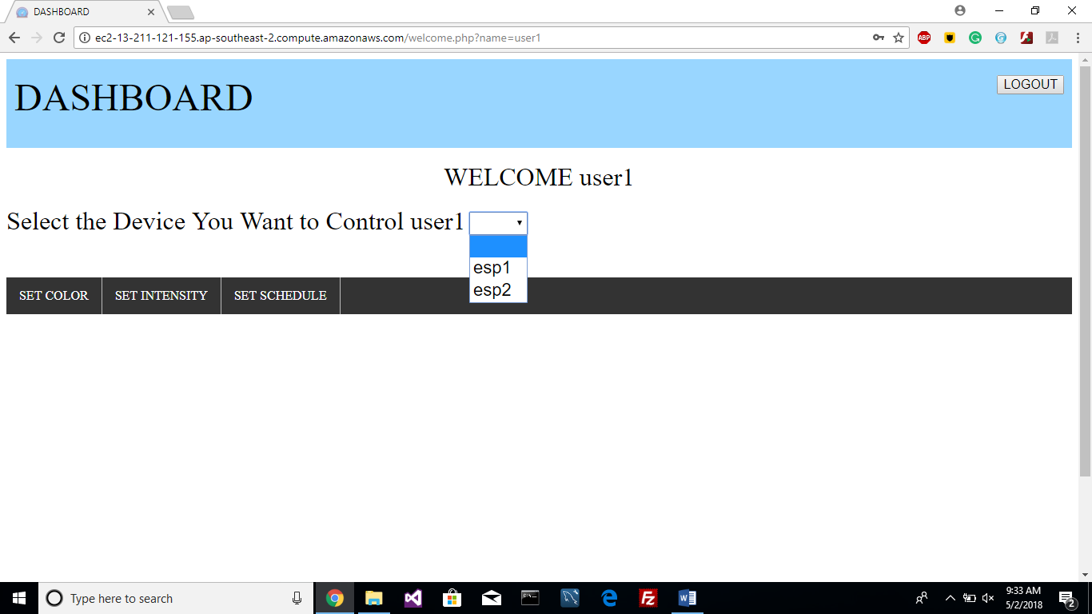
Web Interface
Welcome Page

Slide 20
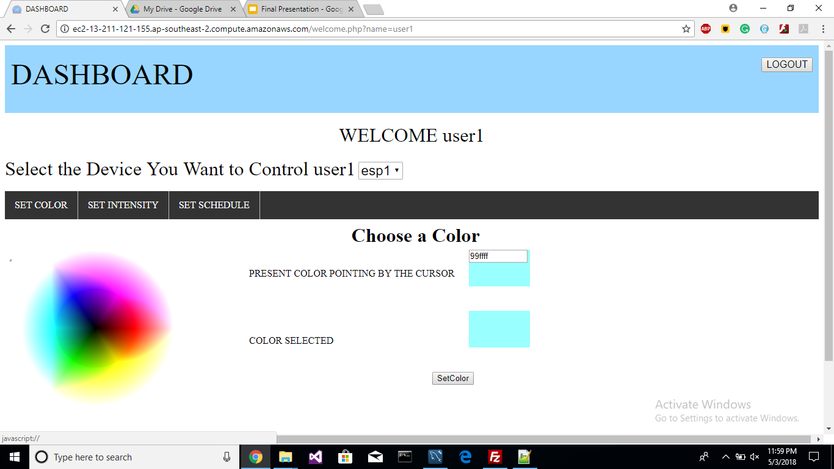
Web Interface
Set Color Page

Slide 21
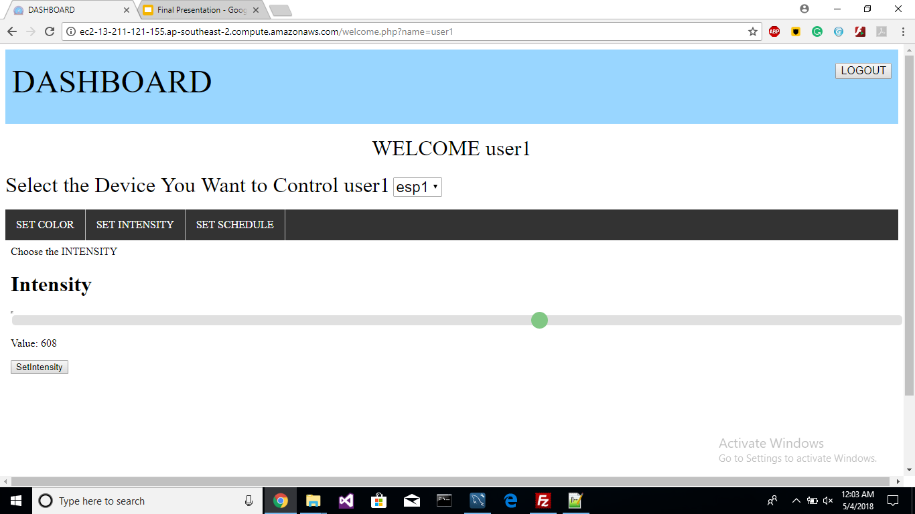
Web Interface
Set Intensity Page

Slide 22
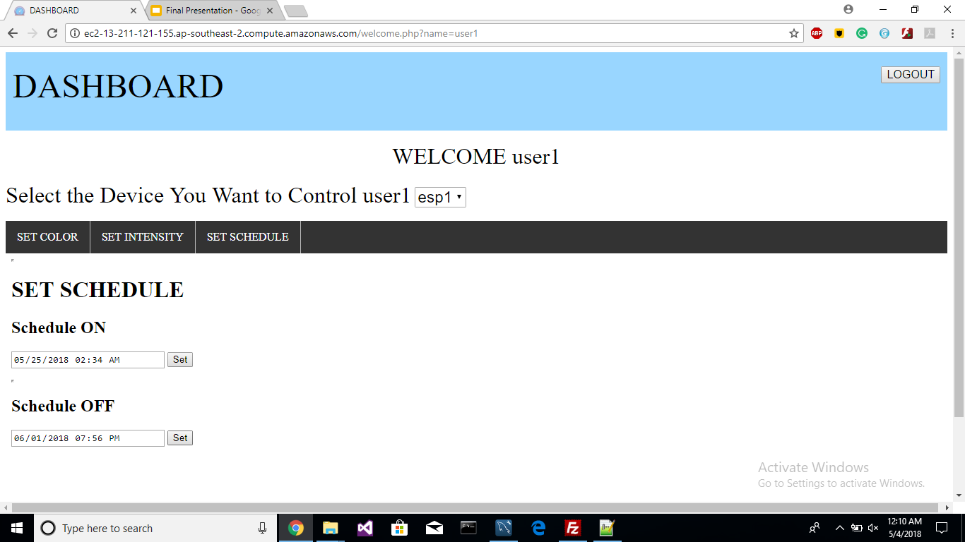
Web Interface
Set Schedule Page

Slide 23
Testing
TEST | Memory Usage | Delay | Storage | Security | Stability
Mobile Application | 15 MB | < 3 Sec | 3 MB | QR Code | Good
NodeMCU | Nearly 4 KB | ~ 5 ms | 45 KB | Password | Excellent
AWS | < 1 GB | ~ 10 ms | 25 GB (Cloud) | Permission File | Excellent
Database | ……… | ~ 7 ms | ……… | User Authentication | Good

Slide 24
Conclusion
Mobile app is created successfully with required functionality using Xcode, Arduino Workbench, MySQL DB and AWS Instance.
AWS as a cloud service offers immense functionality though it is complex to setup when compared to a traditional network. Support for NodeMCU is limited.
AWS could be further explored for device management and cloud security to work with a network of connected devices.
NodeMCU is the most economical way to implement AWS IoT applications. It offers both basic and advanced programmable hardware functionality. Support for multiple platforms makes it flexible as well.
MQTT is the primary protocol in play for communicating with AWS IoT server.

Slide 25
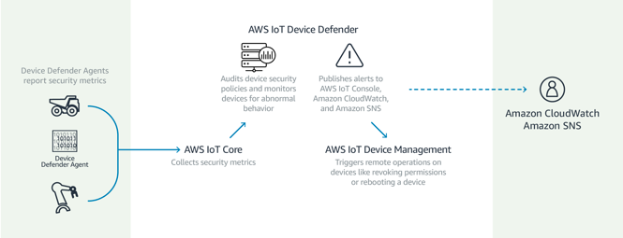
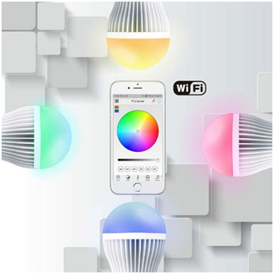


Future Work
Extended Cloud Support
Added Functionality

Slide 26
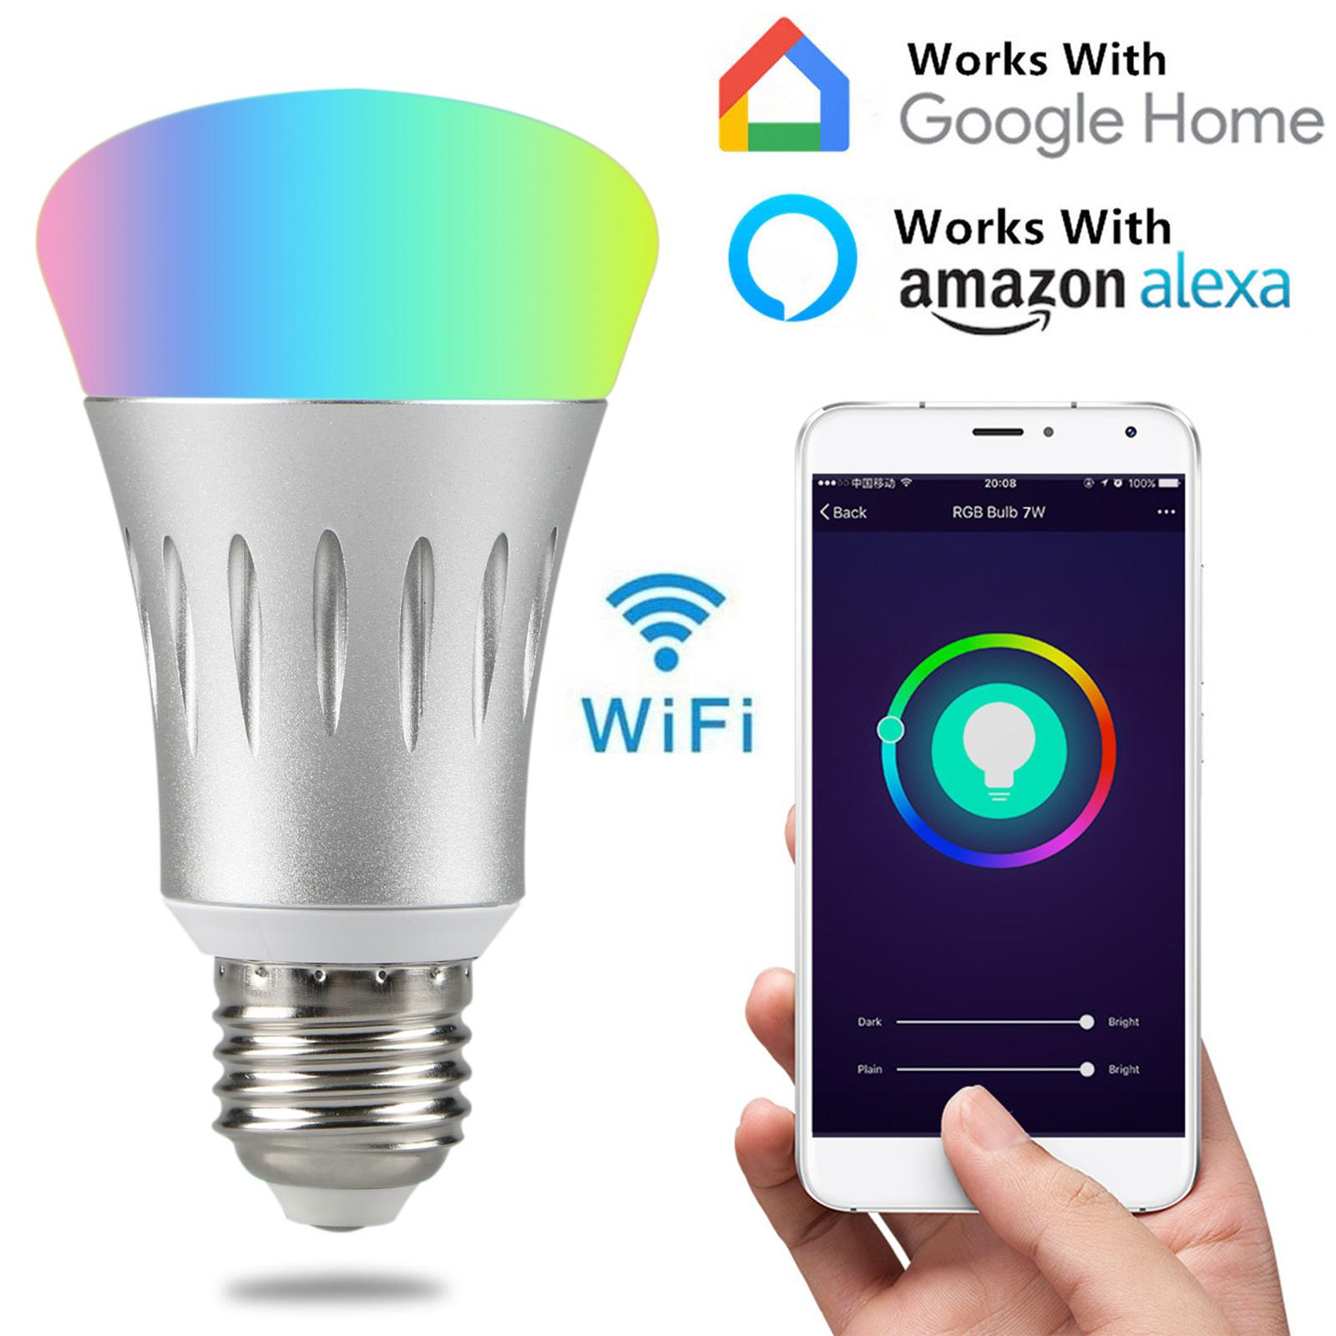

Future Work
Voice Command Machine Learning

Slide 27
References
Bertino, E., Choo, K. R., Georgakopolous, D., & Nepal, S. (2016). Internet of Things (IoT). ACM Transactions on Internet Technology, 16(4), 1-7. doi:10.1145/3013520
P., S., S., S., M., A., & Ushaa, E. (2016). Realizing Internet of Things Using Arduino, ESP8266 and IIS Server and MySQL DB For Real-Time Monitoring and Controlling Multiple Fire Alarm Systems Over a Wireless TCP/IP Network. I-manager’s Journal on Software Engineering, 11(2), 13. doi:10.26634/jse.11.2.13444
P, P. (n.d.). Beginners guide to ESP8266, from https://tttapa.github.io/ESP8266/Chap04 - Microcontroller.html
Understanding the 802.11 Wireless LAN MAC frame format. (2017, April 26), from https://witestlab.poly.edu/blog/802-11-wireless-lan-2/
Kodali, R. K., & Soratkal, S. (2016). MQTT based home automation system using ESP8266. 2016 IEEE Region 10 Humanitarian Technology Conference (R10-HTC). doi:10.1109/r10-htc.2016.7906845

